Slide 1

Task Management System
By: Benjamin Brandt, Andrew Lombardo, Nick Muratore, Chris Castillo
d

Slide 2
Team Introduction
Andrew Lombardo (Team Head)
Freshman
Computer Science - Program Development/Data Systems
Christopher Castillo
Freshman
Computer Science – Game Design & Programming
Nicholas Muratore
Senior
Cybersecurity
Ben Brandt
Freshman
Computer Science - Software Development

Slide 3
Project outline
A Task management system that displays a calendar with desired tasks by a weekly, monthly, or yearly categorization
A user can add, remove, search, edit tasks and input specific data
Duration, time, title, description of tasks
An admin can do everything a user can, plus can add, edit and remove users

Slide 4

Graphical UX Design

Slide 5
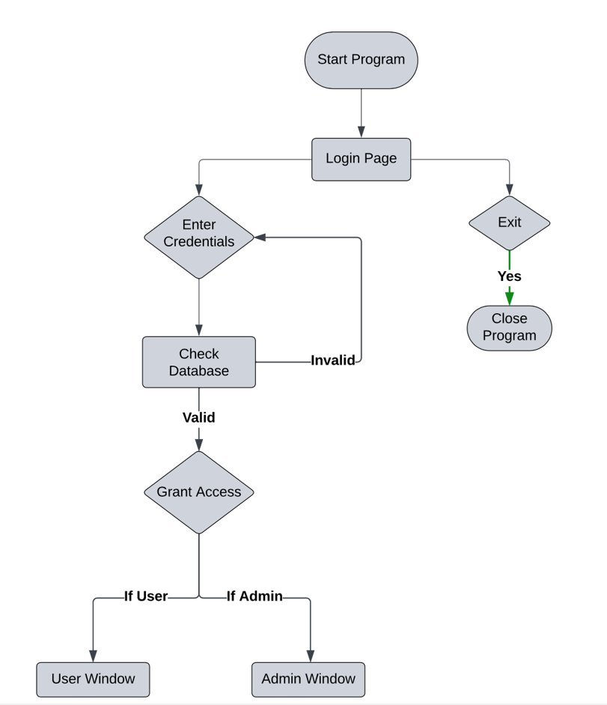
Login Page

Slide 6
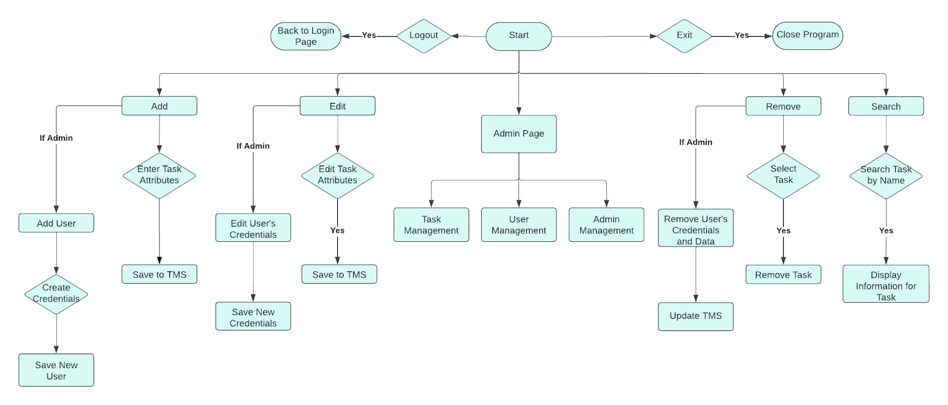
Main Page

Slide 7
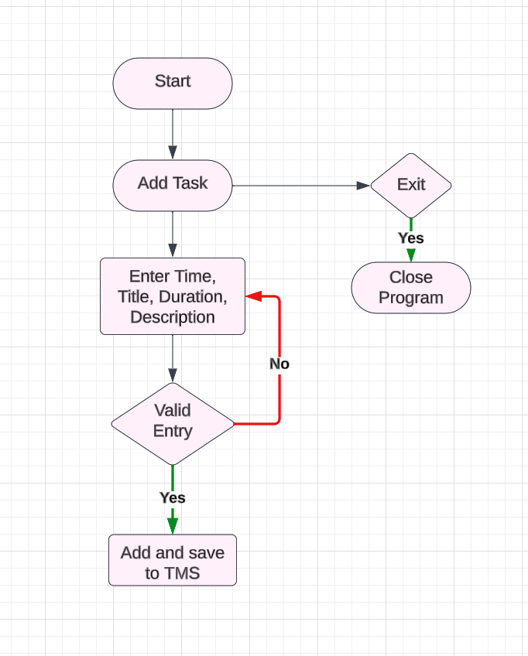
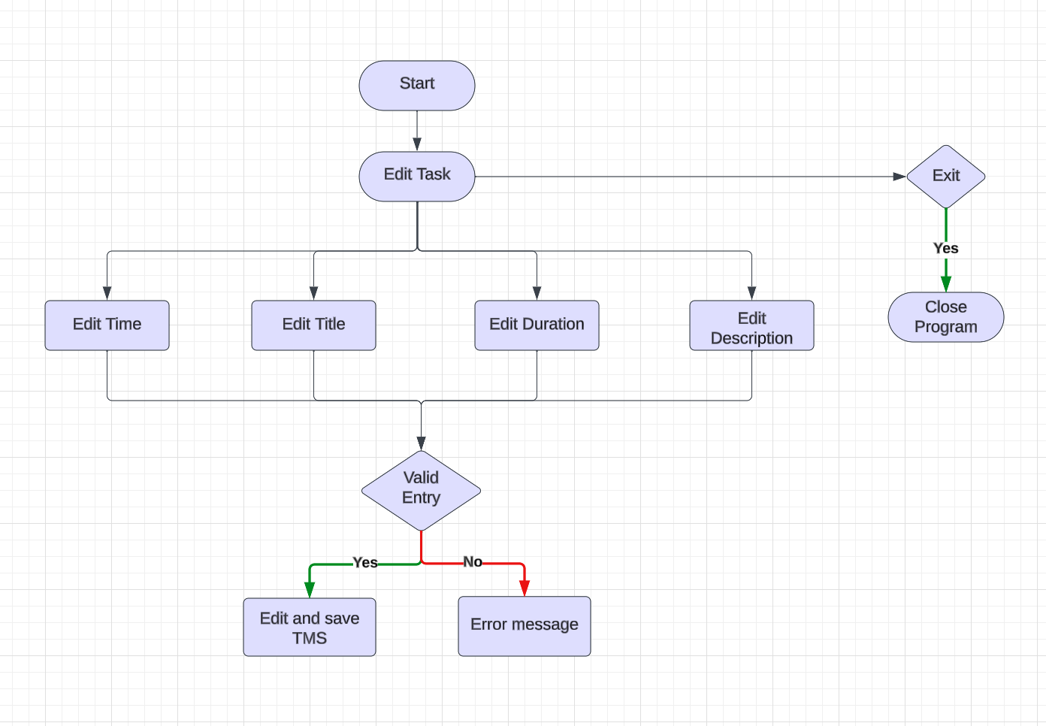
ADD TASK
EDIT TASK

Slide 8
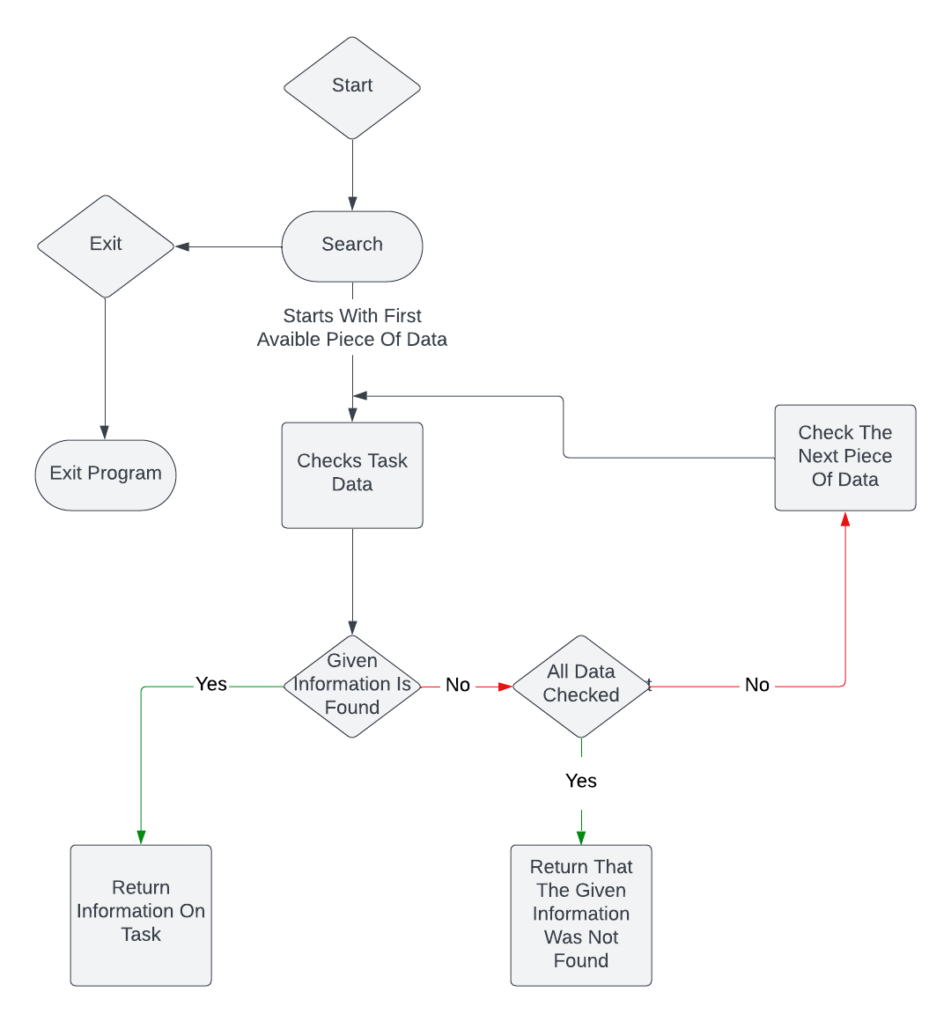
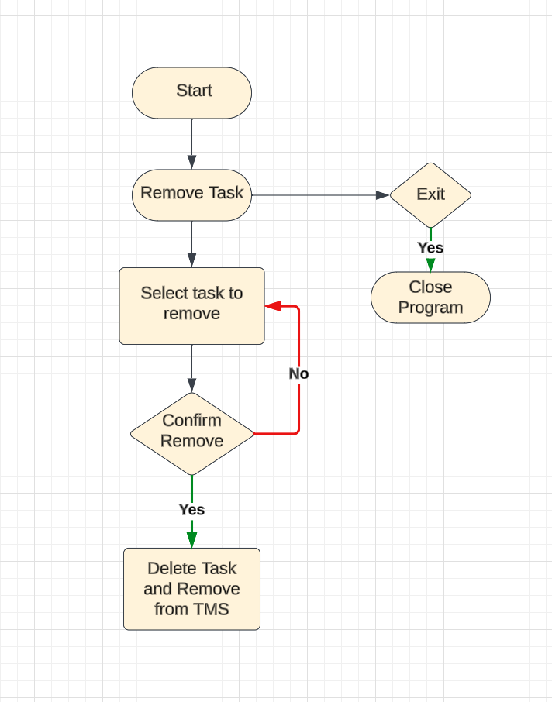
Search Task
Remove Task
8

Slide 9
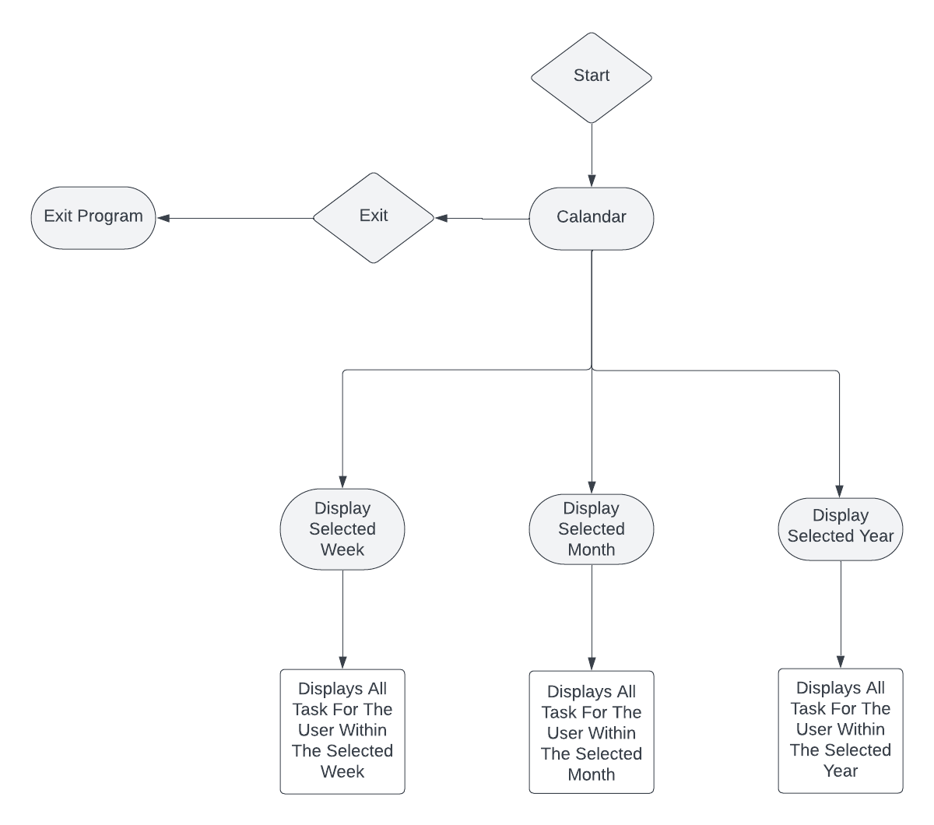
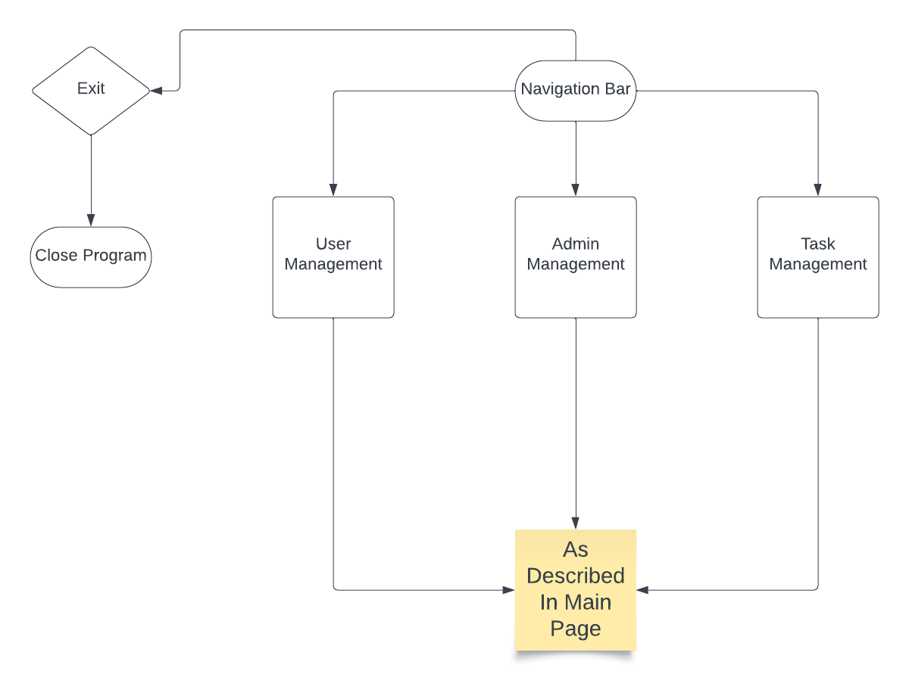
Calendar
Navigation Bar

Slide 10
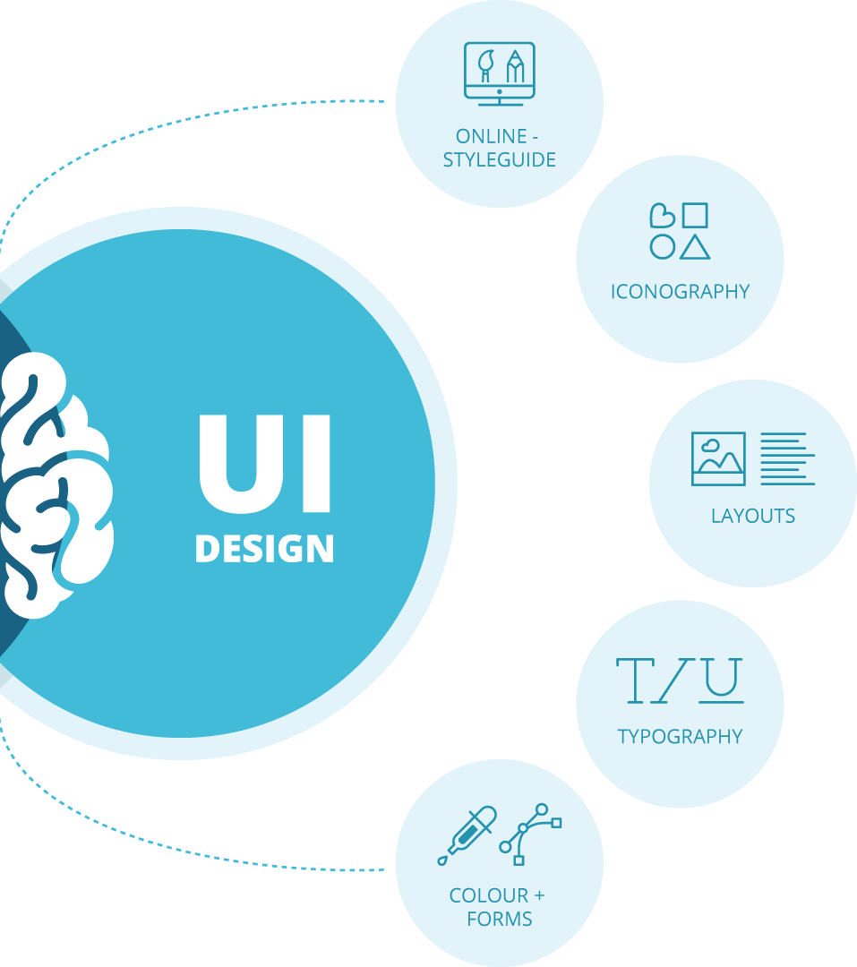
Graphical UI Design

Slide 11
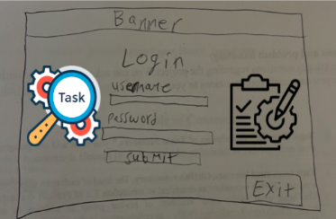
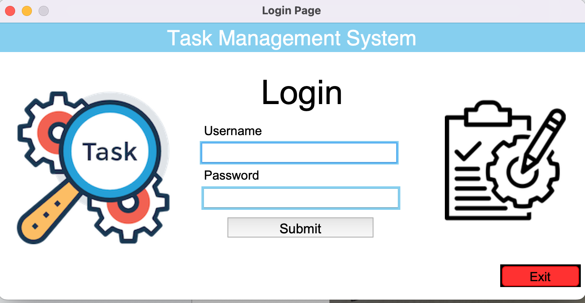
Login Layout
Python Implementation

Slide 12
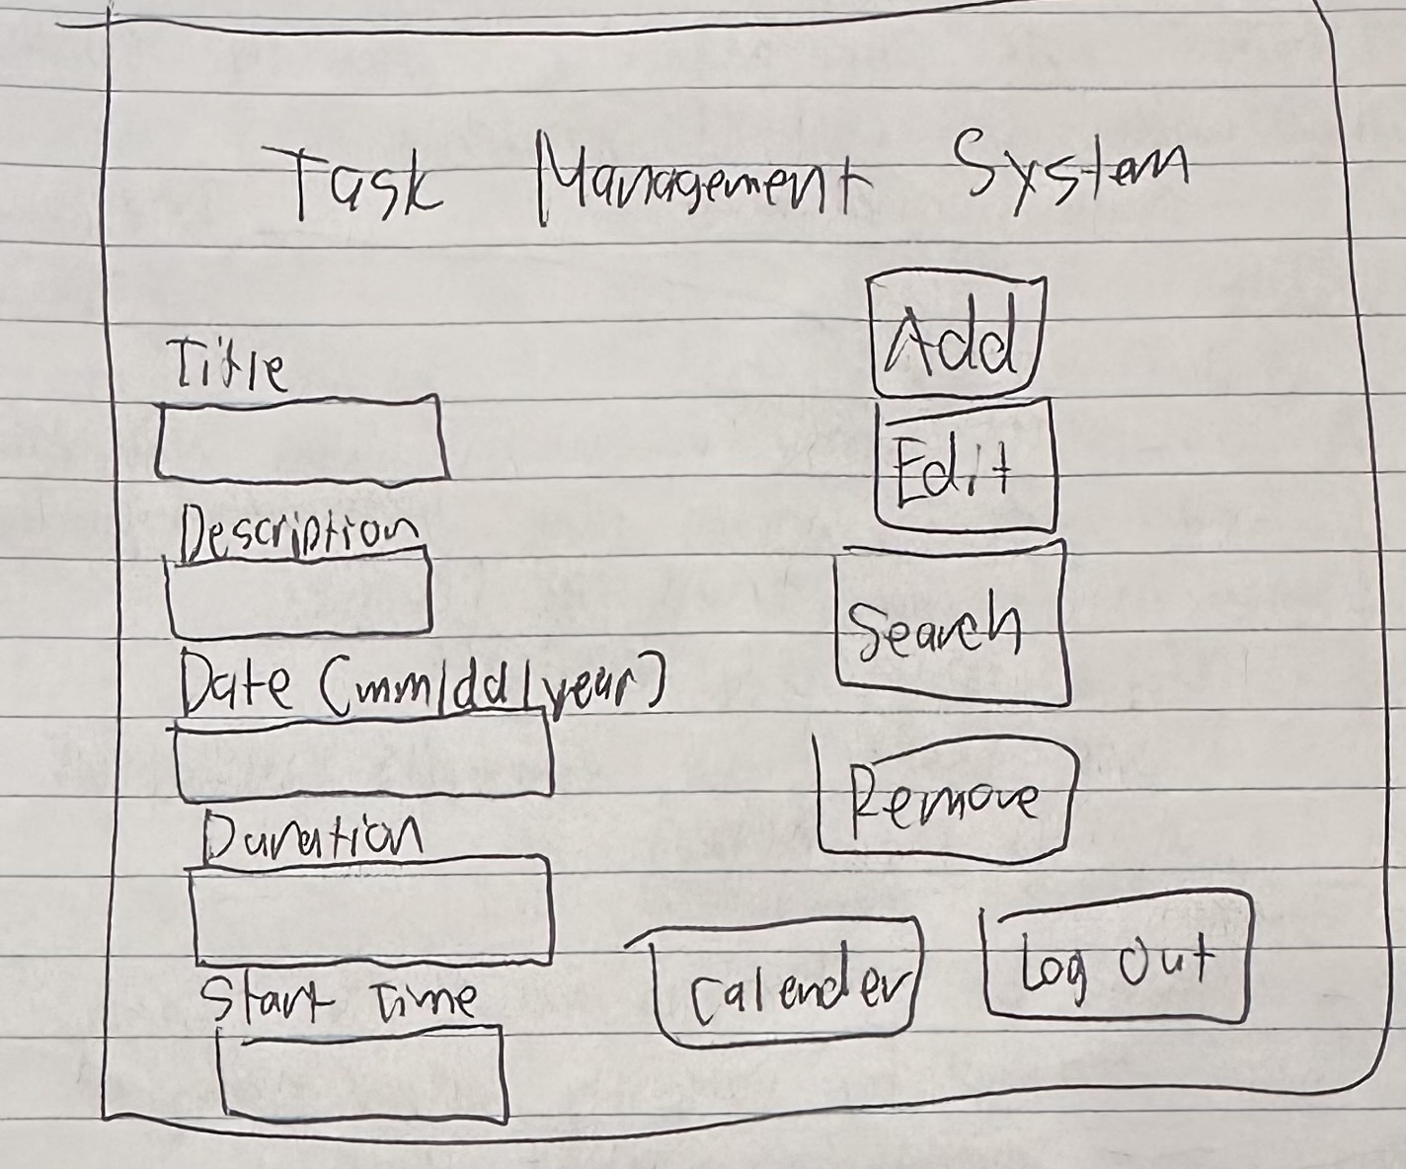
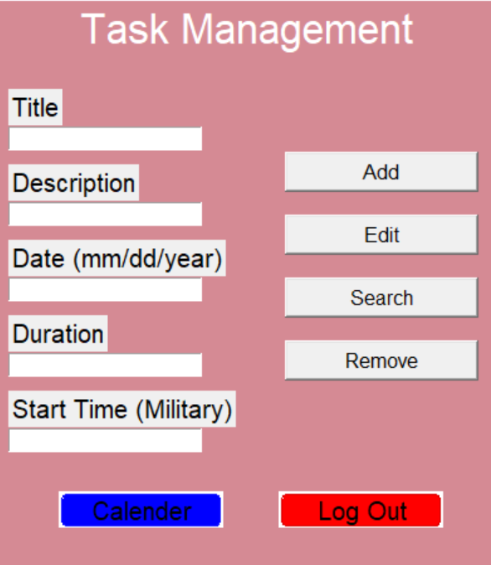
Task Management Layout
Python Implementation

Slide 13
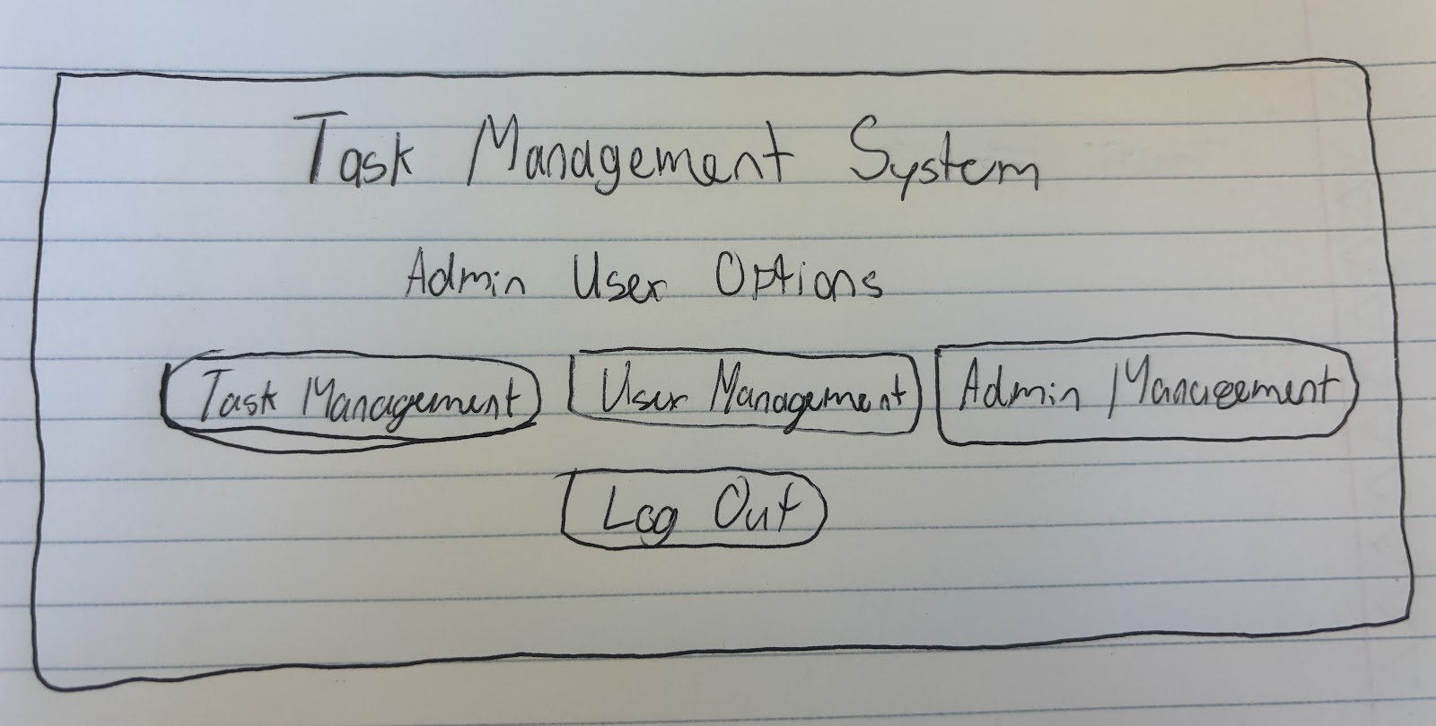
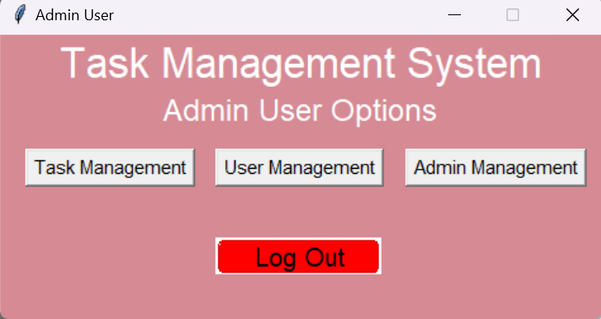
Admin Management Layout​
Python Implementation​

Slide 14
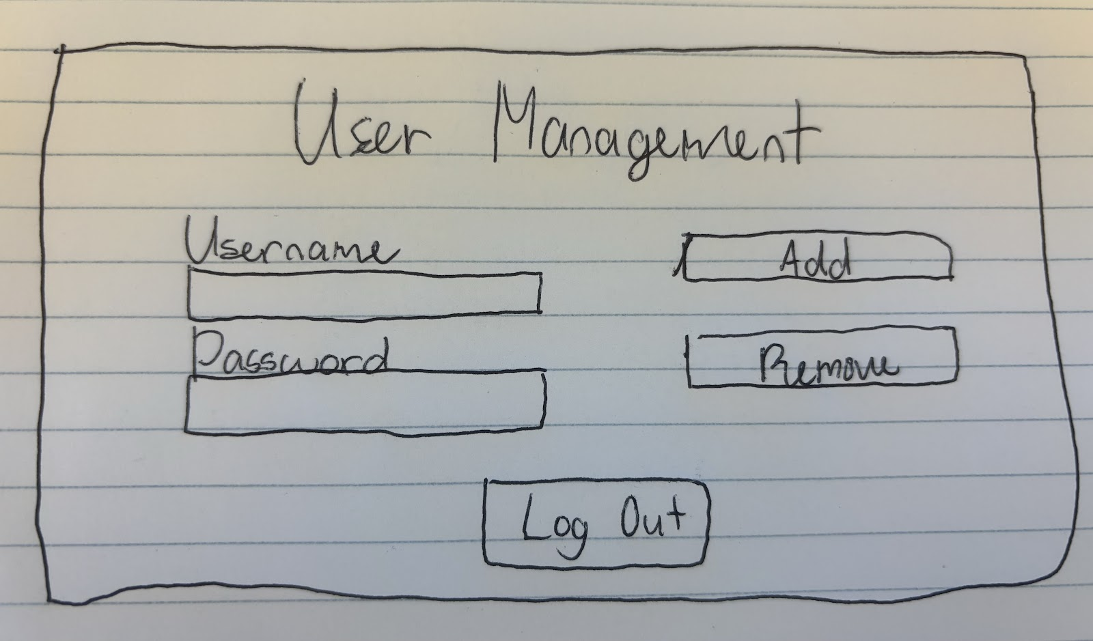
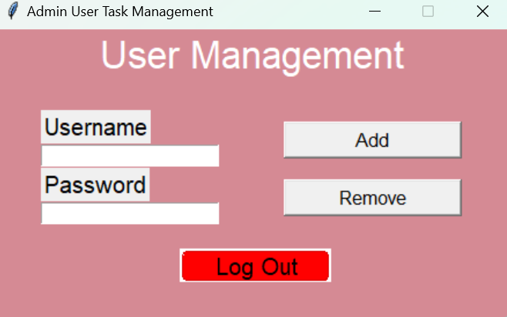
User Management Layout​
Python Implementation​
Task Management System – Christopher Castillo, Nick Muratore, Benjamin Brandt, and Andrew Lombardo

Slide 15
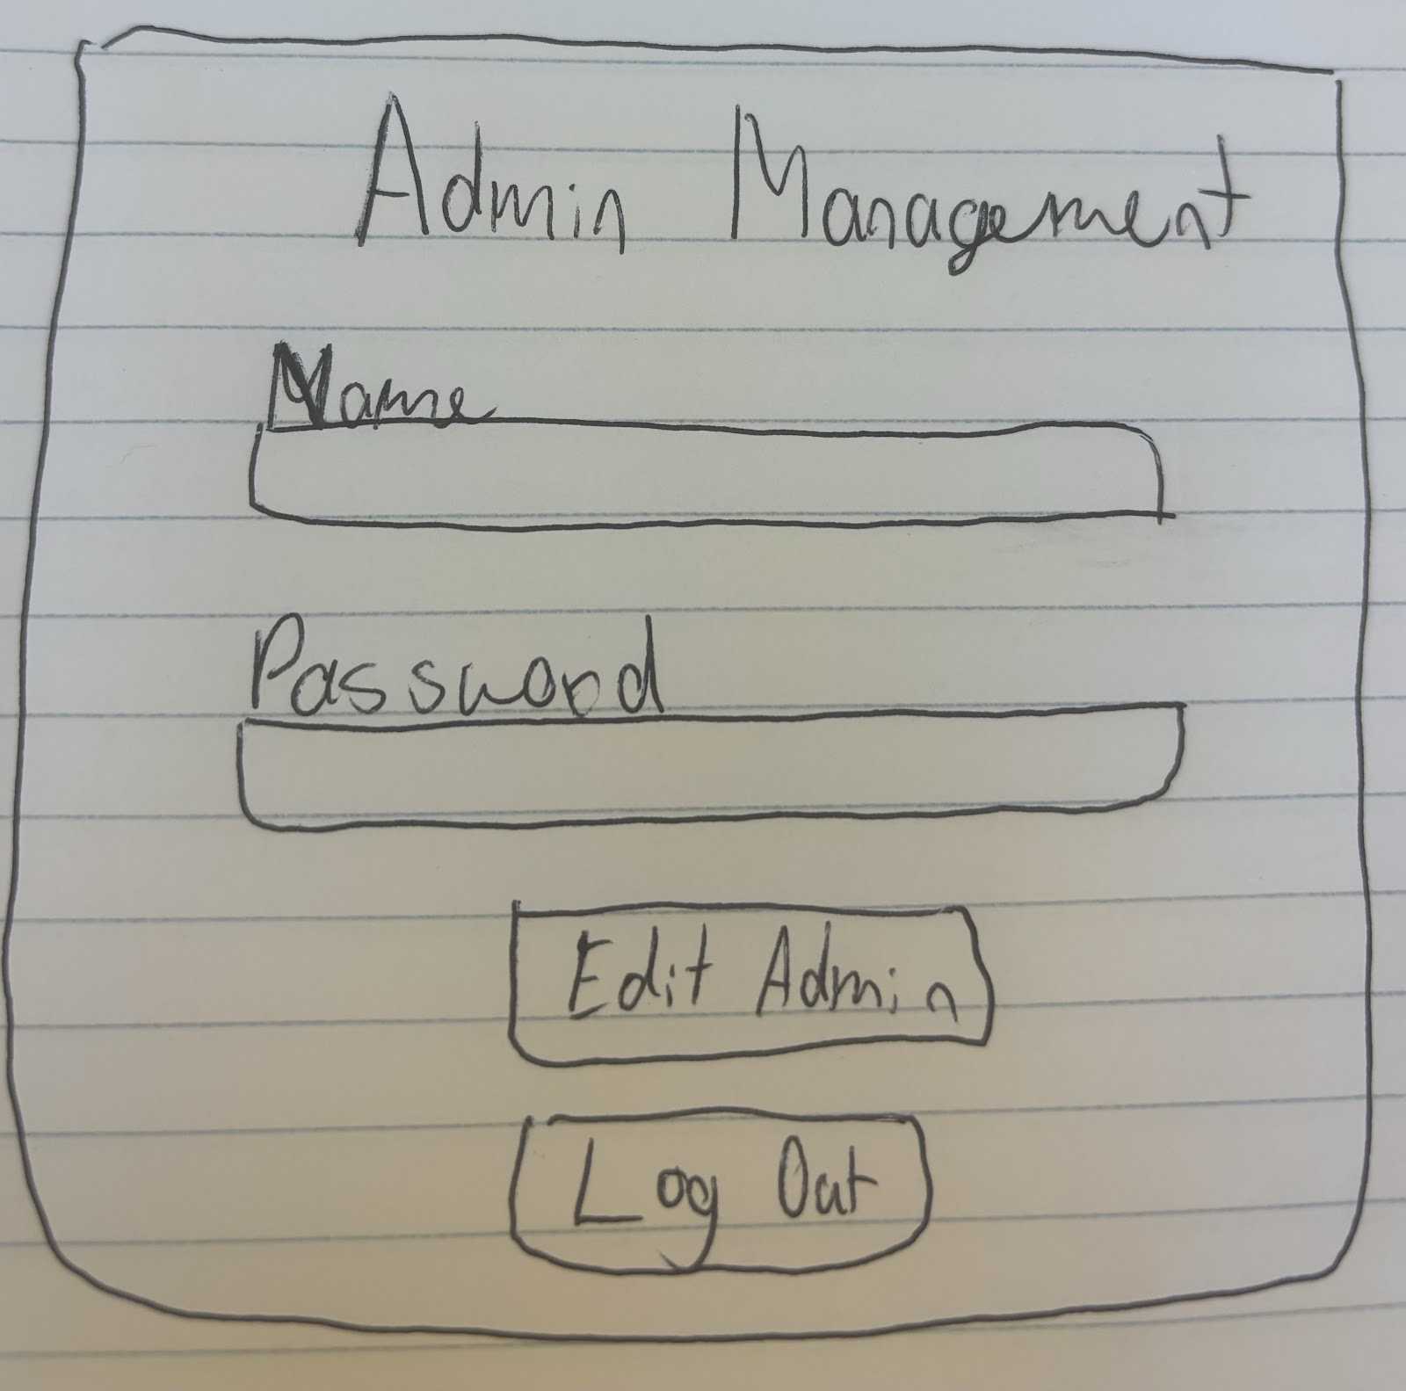
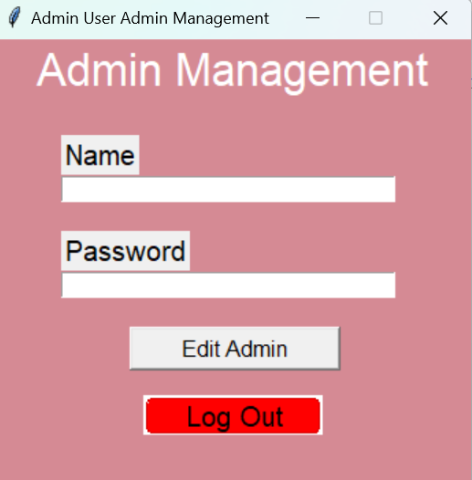
Admin Management Layout​
Python Implementation​
Task Management System – Christopher Castillo, Nick Muratore, Benjamin Brandt, and Andrew Lombardo

Slide 16
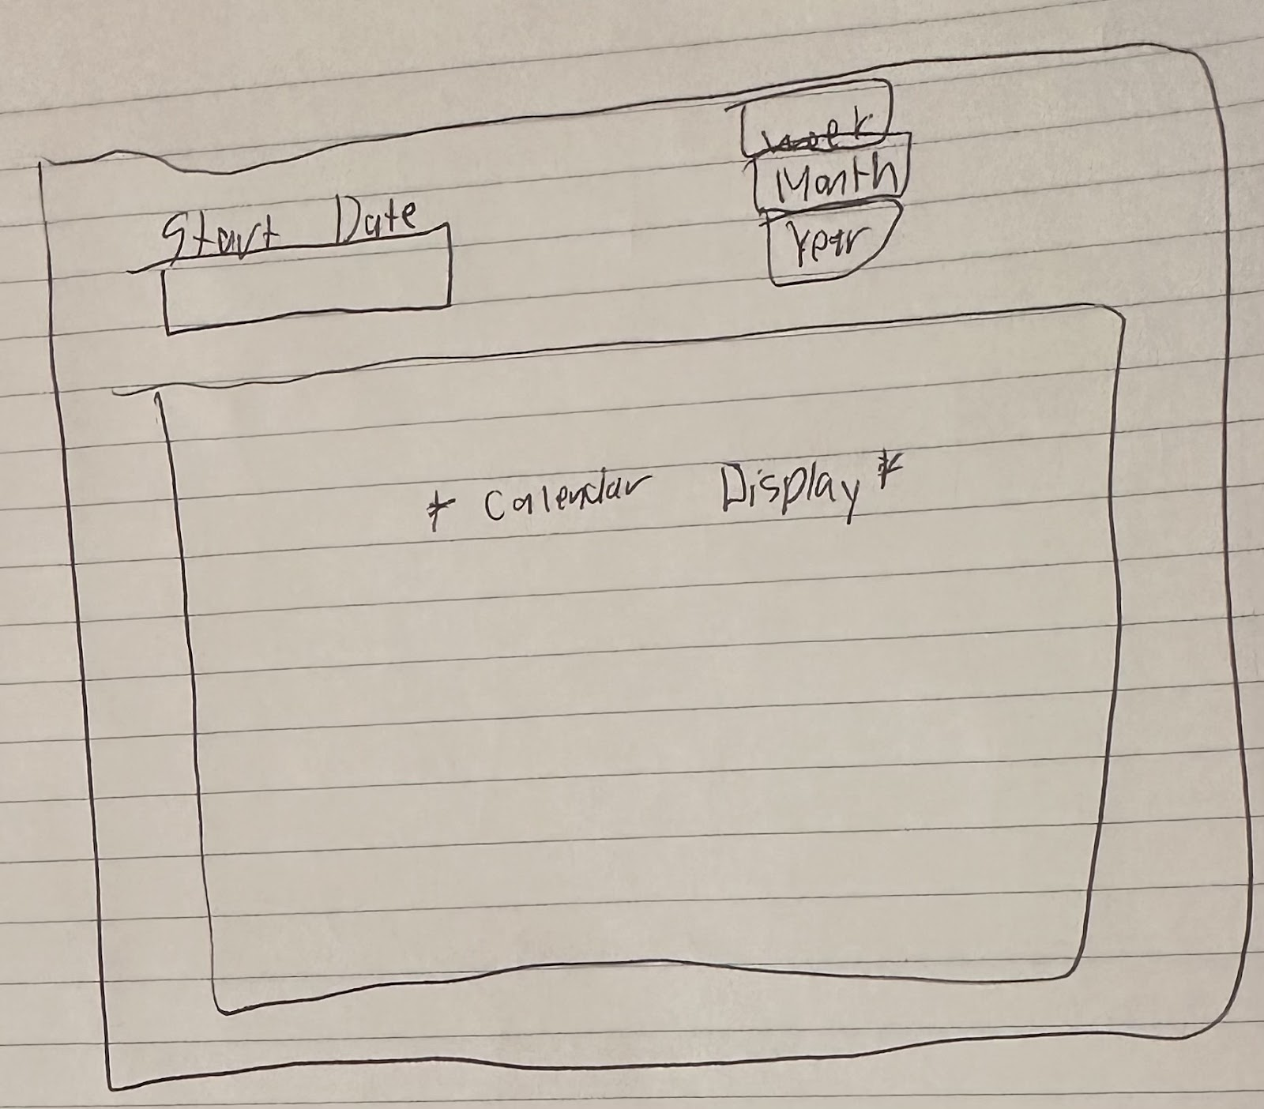
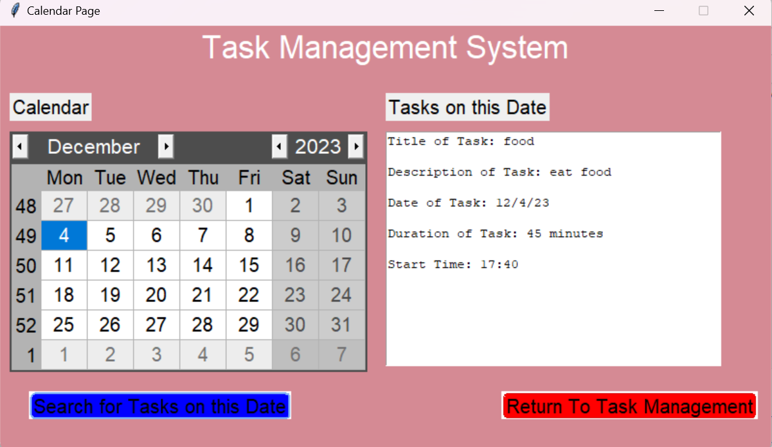
Calendar Layout
Python Implementation​
Task Management System – Christopher Castillo, Nick Muratore, Benjamin Brandt, and Andrew Lombardo

Slide 17
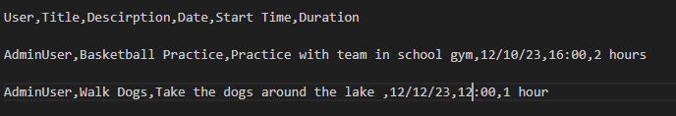


Data storage

Slide 18
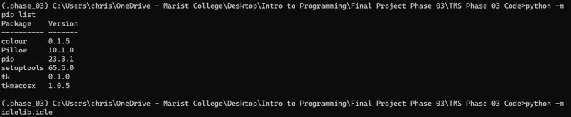
Virtual Environment

Slide 19
Demonstration of Program

Slide 20
References
Libraries: tkinter, tkmacosx, pillow, tkcalendar
https://www.lucidchart.com
https://www.geeksforgeeks.org/
https://pypi.org/
https://stackoverflow.com/

Slide 21

Thank You!
Contact us at:
benjamin.brandt1@marist.edu
andrew.lombardo1@marist.edu
christopher.castillo1@marist.edu
nick.muratore1@marist.edu
Github Link: https://github.com/Levalvus/Final_Project--Task_Manager--MCSquared

